Slide 1
PRESENTATION TITLE
Hw
S10241971
​

Slide 2
AGENDA
Text Data Preprocessing
Text Data Understanding
Summarize the findings​

Slide 3
Data understanding
Extract keywords using TF-IDF matrix
Transform use of wordcloud and bar graphs to visualize the data
Analyze extracted keywords using association rule mining

Slide 4
Text Data Preprocessing
Download and cleanse text
Transform text

Slide 5
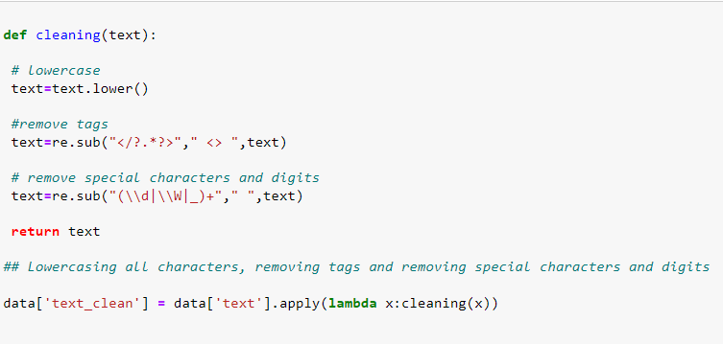
Handling tags and special characters
lower(). Lowercases all letters
Regex used to remove tags, special characters/ and digits
Reduce noise of dataset by removing meaningless characters

Slide 6

Tokenization
Text is split into individual words
Tokenized text used for removal of stop words and lemmatization

Slide 7
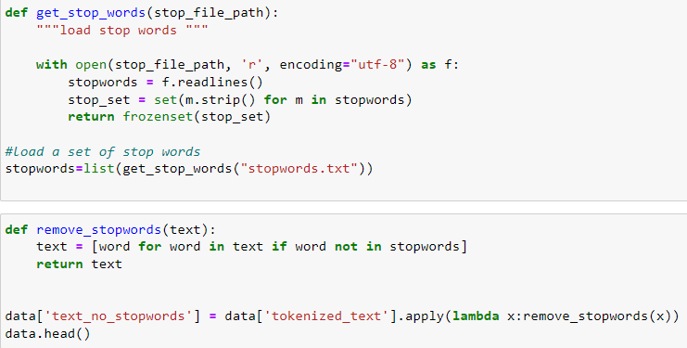
Removal of stopwords
Stop words are commonly used words in everyday language E.g. is , and
Remove stop words as they do not add semantic meaning to document
Adds noise for the model

Slide 8
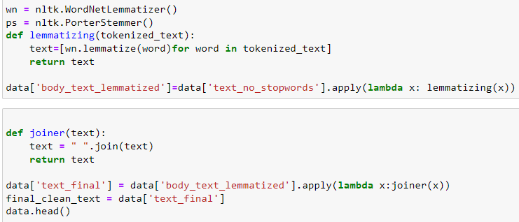
Lemmatization
Converts words to base form E.g. sleeping → sleep
Increase model’s speed by reducing noise
Takes word’s context into account

Slide 9
Transform text

Slide 10

Bag of words
Converts data frame into sparse matrix
Words that appear more frequently then max_df set gets removed
Ignore words that provide little insight
Max number of words to keep set to 5000

Slide 11
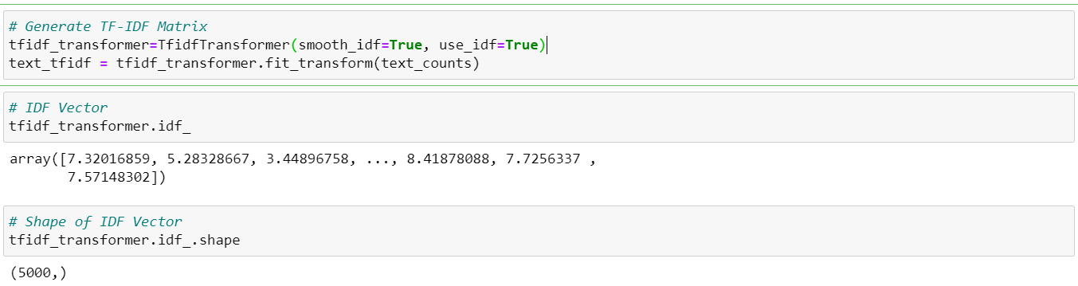
TF-IDF
Converts bag of words matrix to TF-IDF matrix
Smooth_idf adds 1 to frequencies of words, preventing 0 division error

Slide 12
Extracting Keywords

Slide 13
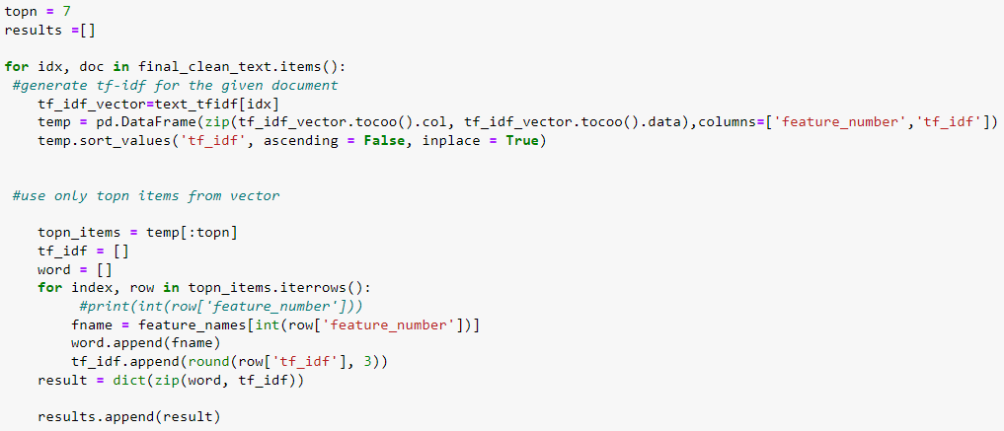
Extracting keywords
Top 7 words with highest TF-IDF value from each document
Focus on words that are more relevant to the document

Slide 14
VISUALIZATION

Slide 15
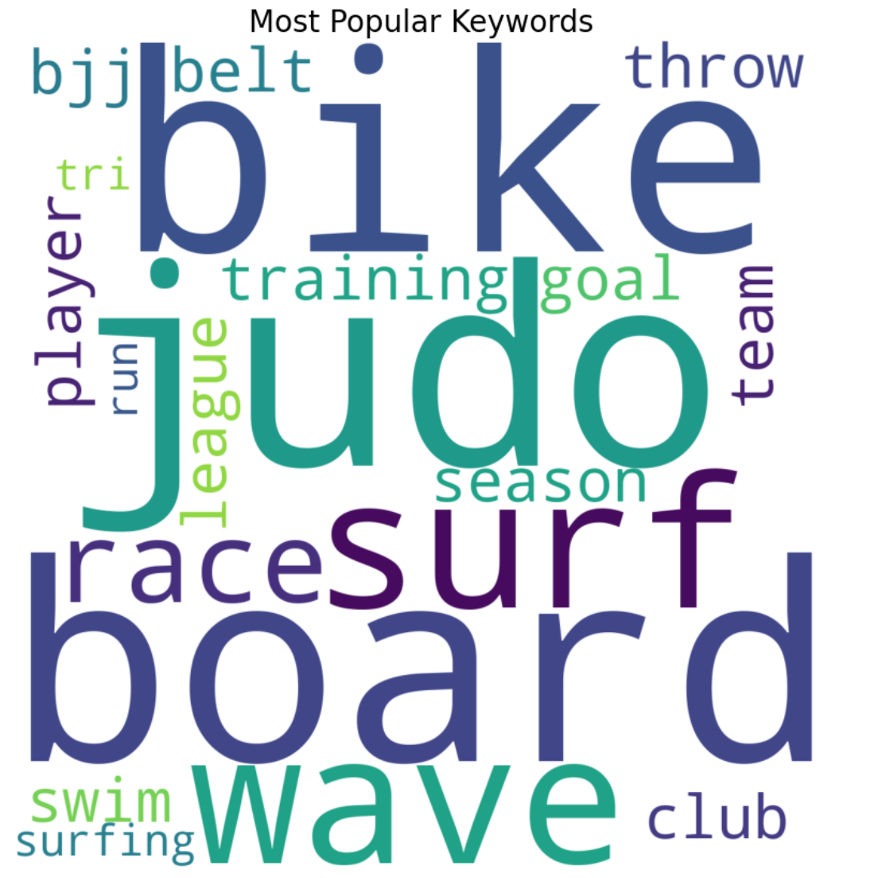
WORDCLOUD
Bigger = More frequently used
Easily see most frequently used words
Hard to compare words that are similar in size such as “board” and “judo”

Slide 16
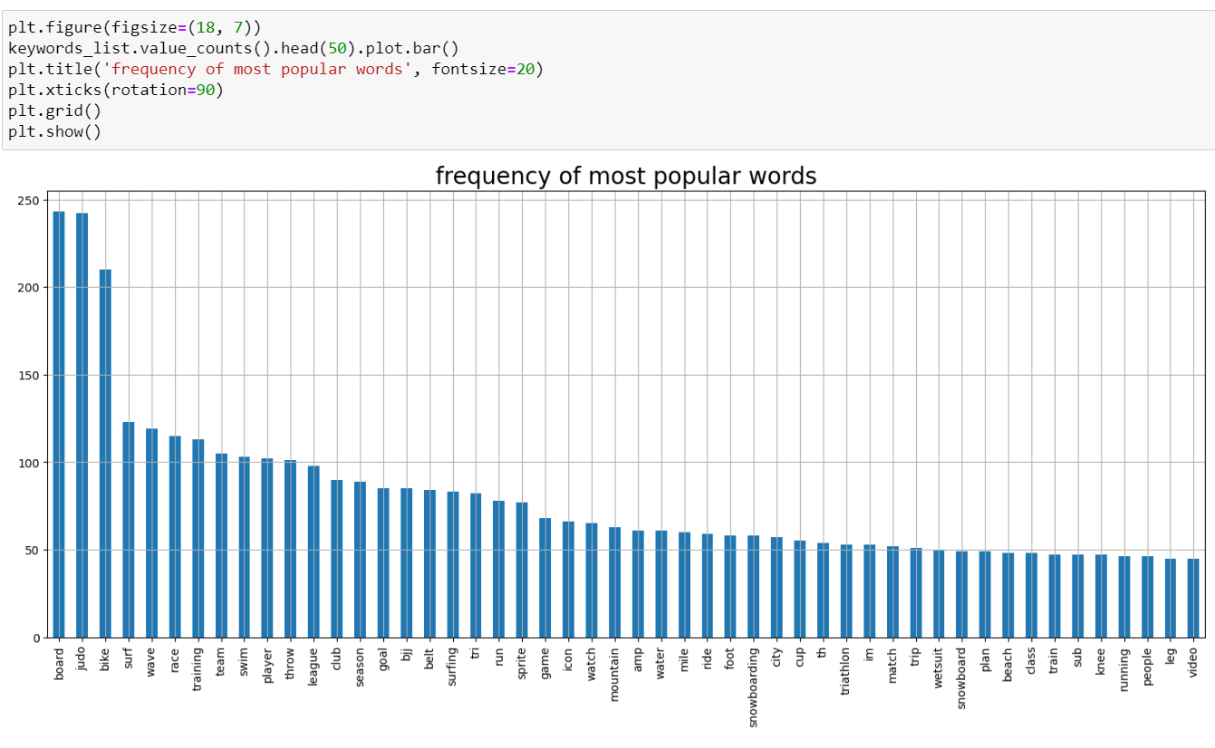
Bar graph
Shows top 50 most used word
Easier to compare the frequency of different words
Top 5 is board, judo, bike, surf and wave

Slide 17
Association Mining for individual category

Slide 18
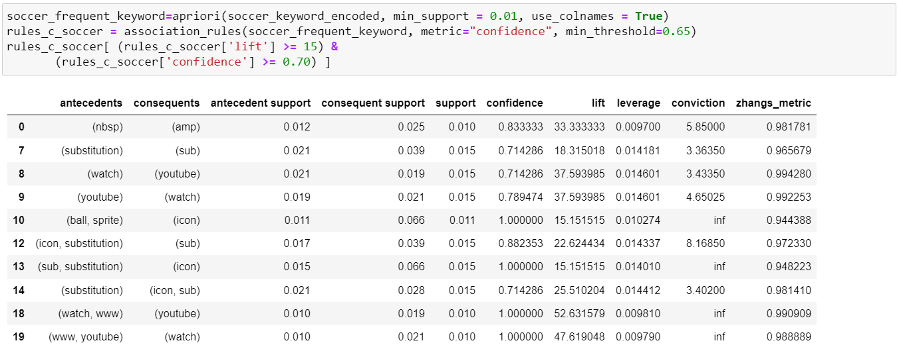
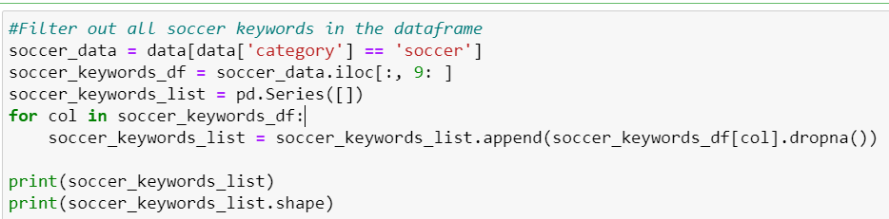
Individual ARM Code
This shows how I extract each category from the dataset for association mining.
This shows how I generate the frequent item set and rules generation.

Slide 19
Analysis for soccer
Articles have mentioned the word icon very frequently.
Sprite icons may be shown as sponsors of soccer matches, and the ball may have a sprite/sponser icon.
Substitution and icon is often linked together, indicating that substitution during soccer matches is discussed often in articles.
The article has mentioned YouTube frequently, indicating that many users watch soccer-related content on YouTube or share YouTube links for soccer-related videos.

Slide 20
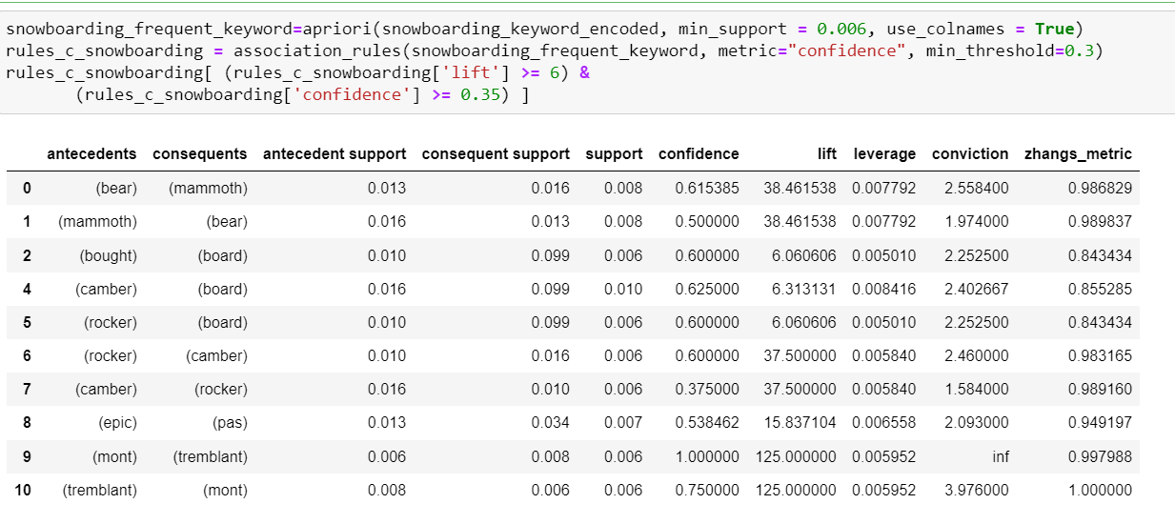
Analysis on snowboarding
Articles mention locations such as Mont Tremblant, big bear mountain resort and mammoth mountain, that is suitable to snowboard.
Types of boards are discussed in the article, such as camber snowboards, and rocker snowboards.
Lastly, Epic pas appeared in articles frequently, indicating that many articles mentioned Epic Ski Pass, which allows buyers to snowboard down certain mountains.

Slide 21
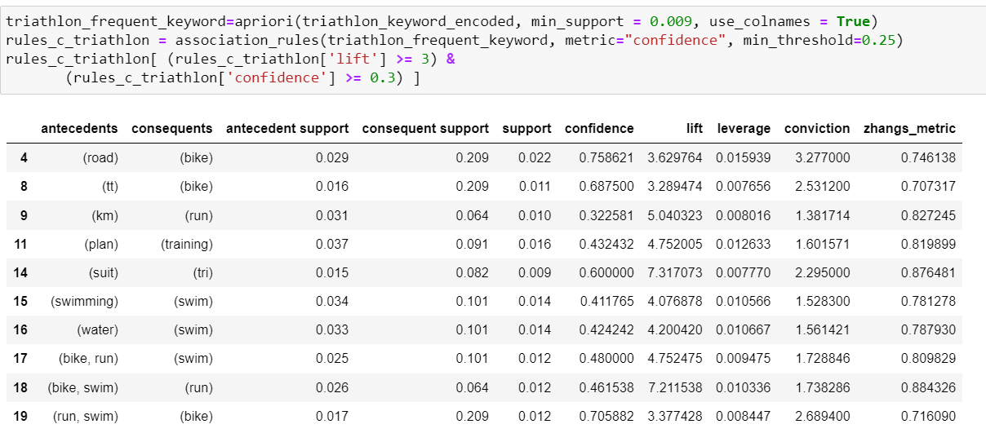
Analysis on Triathlon
Article discusses about equipment for triathlon such as different bikes like road bikes and tt bikes and swimming suits.
Articles mentioned bike, run and swim, which are the activities done in a triathlon.
Running distance may also be seen in many articles

Slide 22
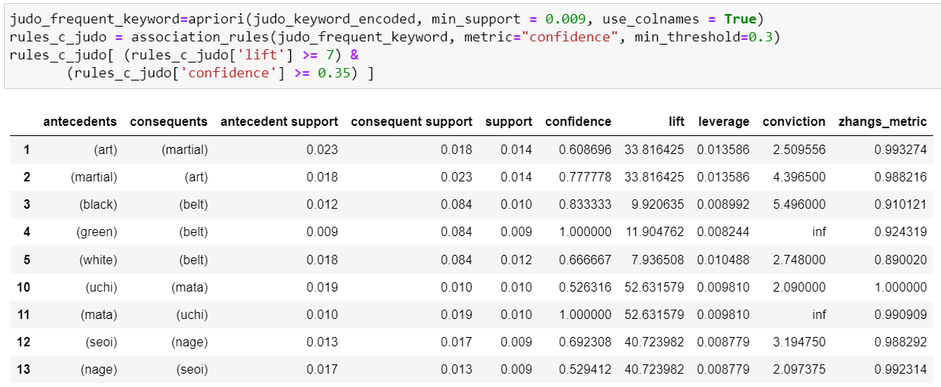
Analysis on Judo
Discuss about different belt ranks such as white, green and black belts.
The article mentioned about different techniques such as seoi nage and uchi mata.

Slide 23
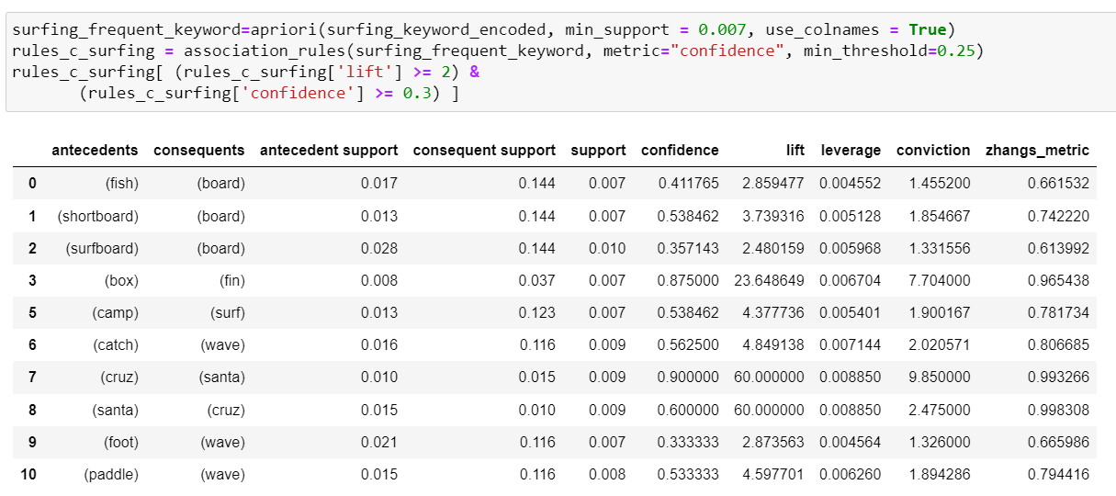
Analysis on Surfing
Surfing articles often discussed about the type of boards such as shortboard and fish board, and the component of the board like the fin box.
There is also mentions of surfing camps, which indicates many user is advertising their surfing camp service
Location for surfing includes Santa Cruz
Techniques for paddling, catching of waves and foot work.

Slide 24
VISUALIZATION analysis

Slide 25
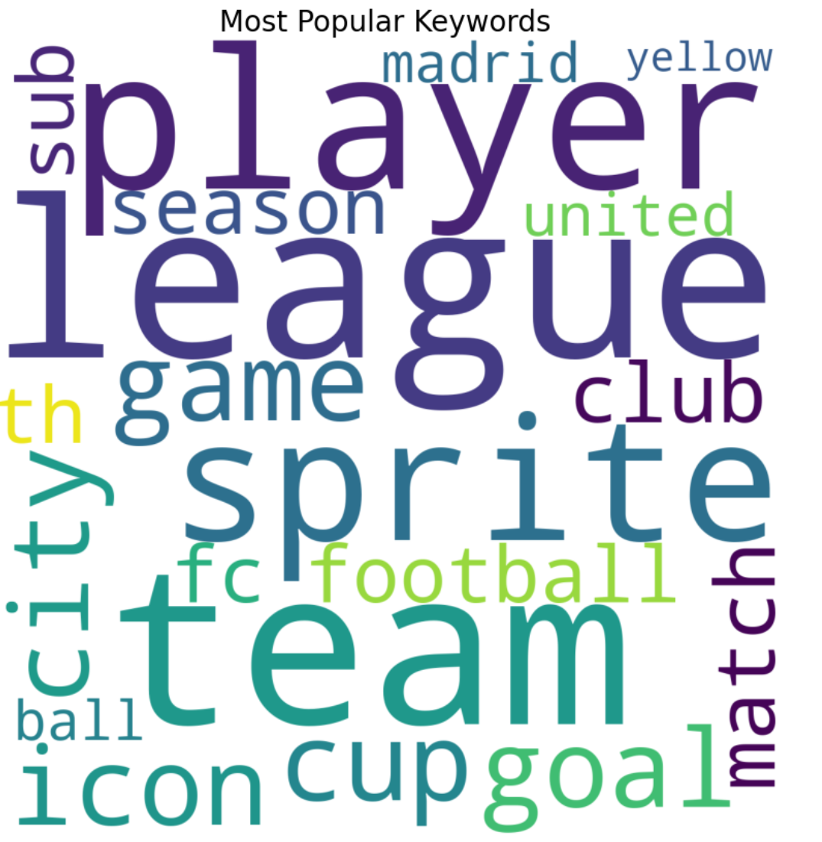
Insight on Soccer Category
Things mainly related to soccer or soccer match (league, team, football, cup, player, goal, match, game)
Drink(Sprite)
Location (city)

Slide 26
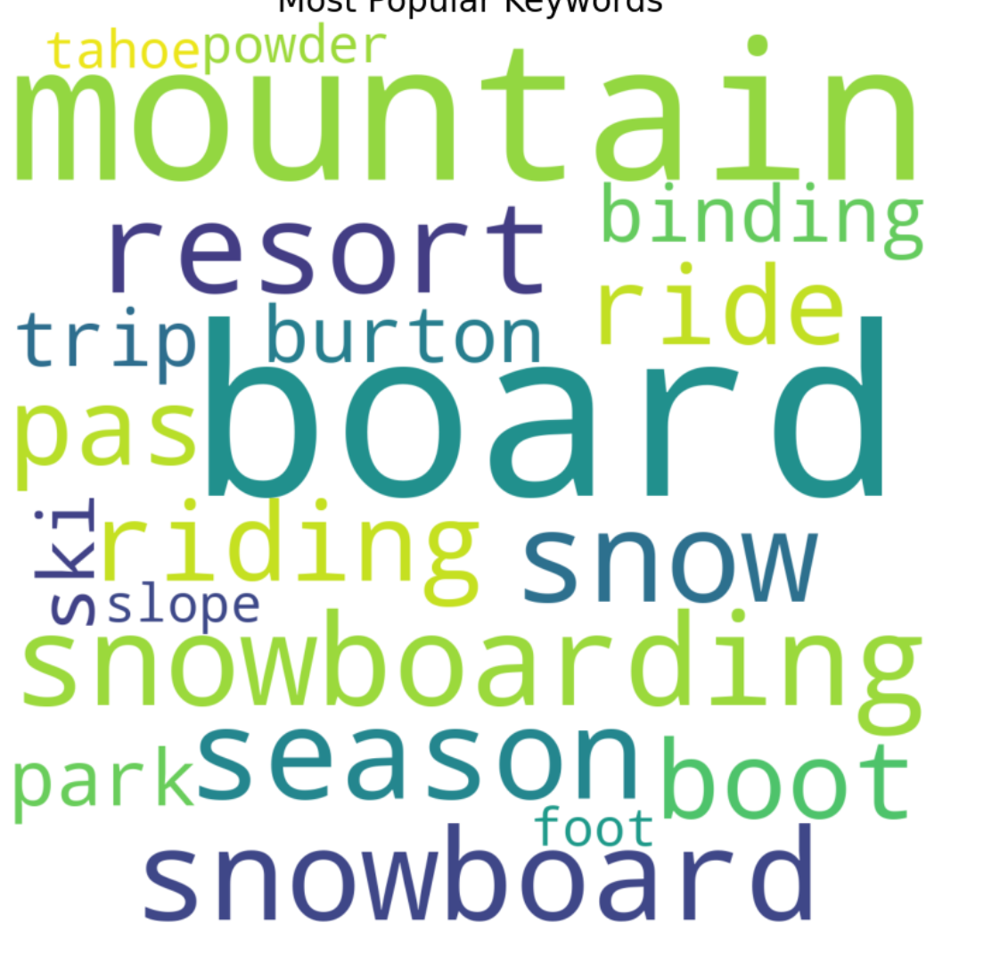
Insight on Snowboarding Category
Snowboarding locations (Tahoe, mountains, resort, park)
Outwear company (Burton)
Ticket (pas)

Slide 27
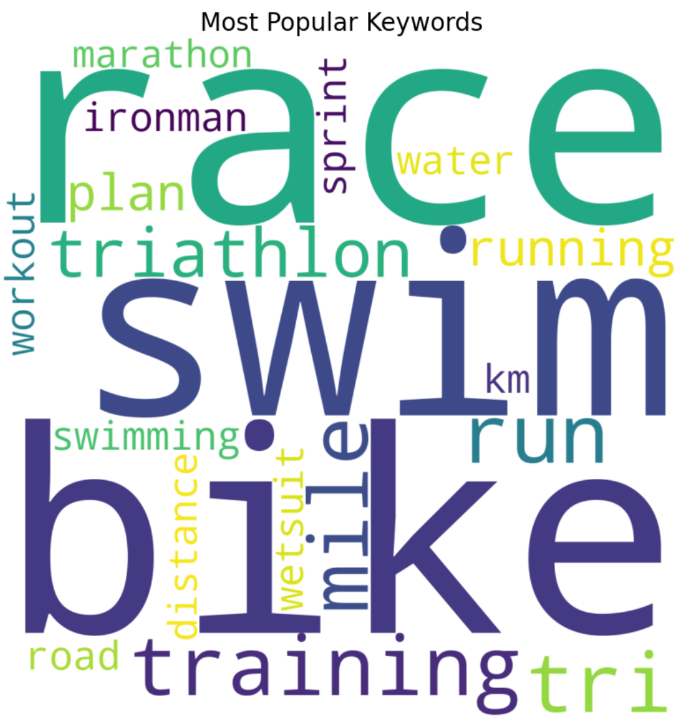
Insight on Triathlon Category
Equipment used (tri, bike, wetsuit)
Experience in triathlon (triathlon, swim, running, riding, road, training, workout)

Slide 28
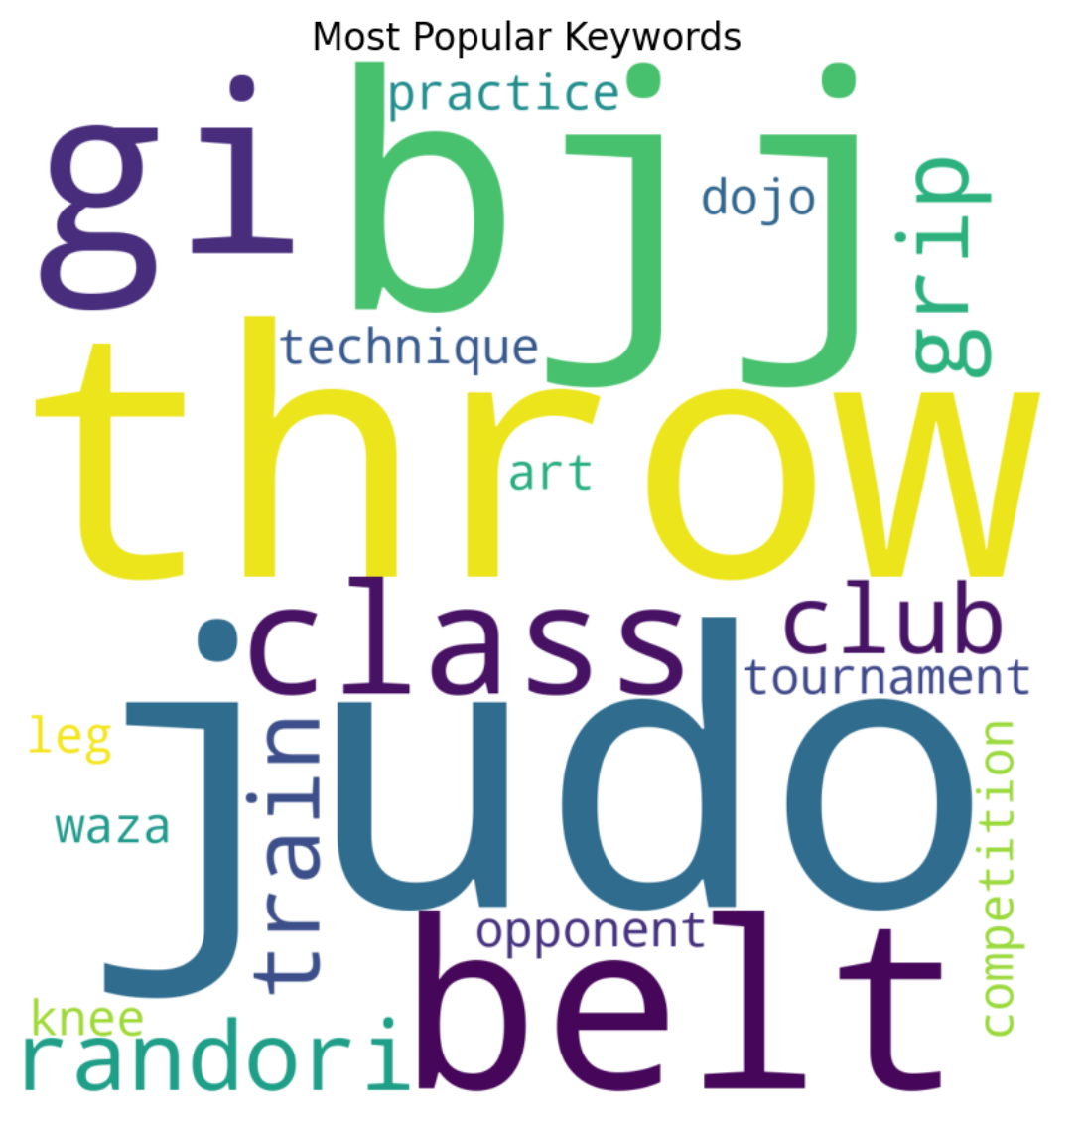
Insight on Judo Category
How people train (Randori, class, club)
Judo-related (opponent, throw, train, practice, grip)
Event (competition, tournament)
Venue (dojo)
Judo uniform (gi, belt)
Techniques (randori, waza)

Slide 29
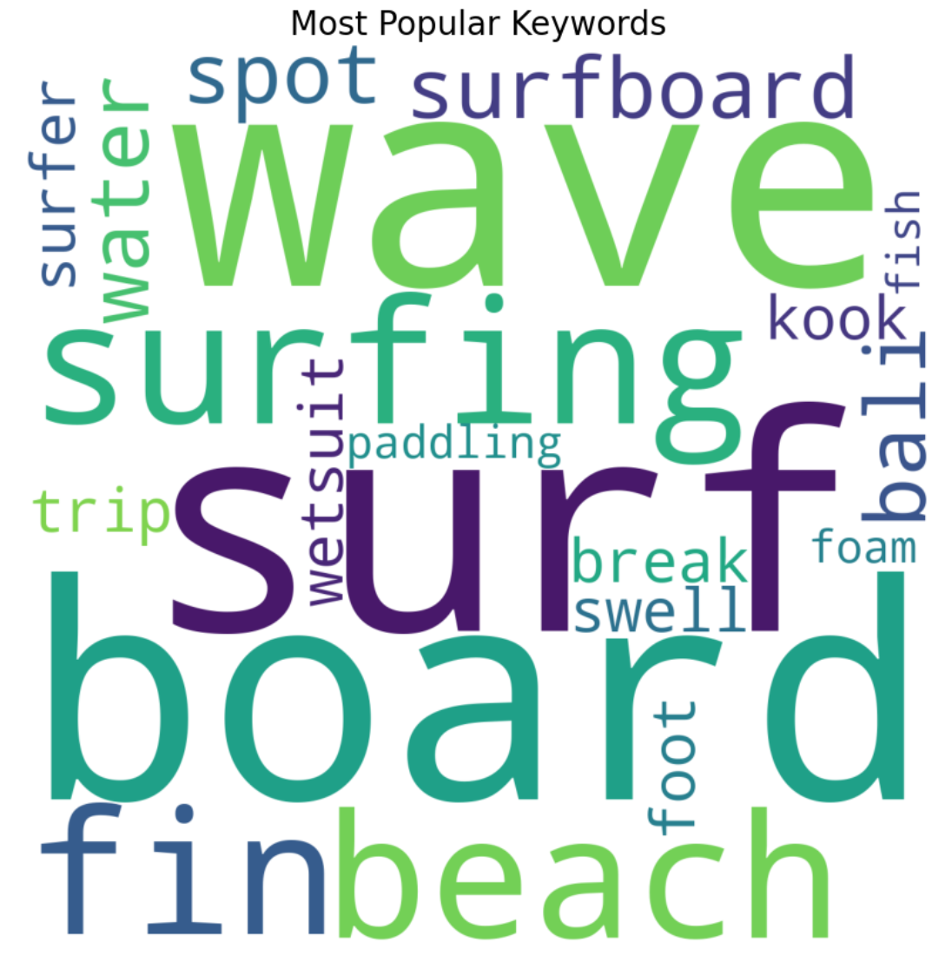
Insight on Surfing Category
Equipment (board, fin, wetsuit, fish, surfboard)
Location (beach, bali)
Surfer(surfer, kook)
Technique for surfing (paddling, foot)

Slide 30
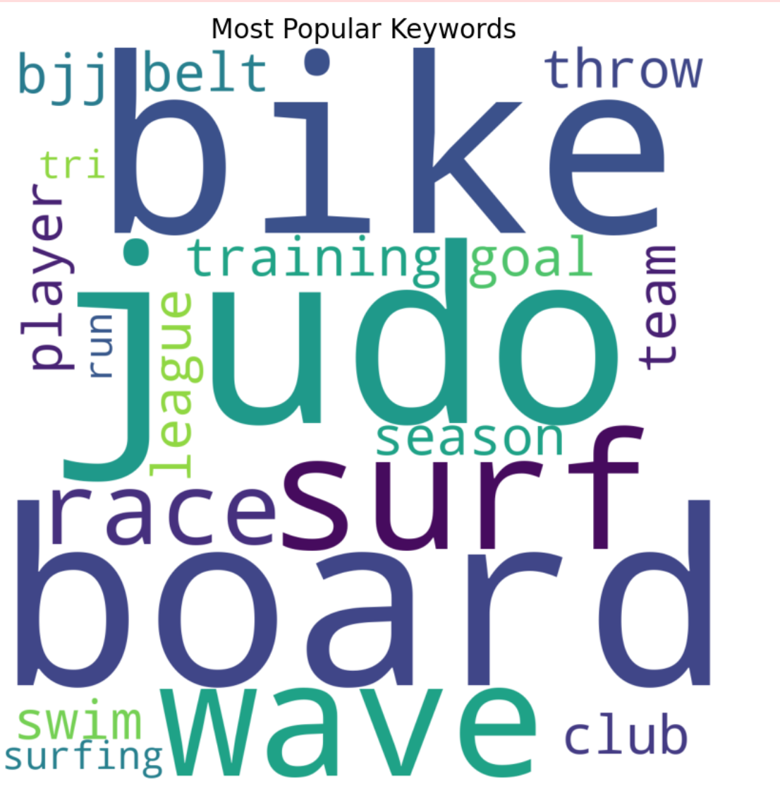
Insight on All Category
Soccer (team, player, season, club, goal, league)
Snowboarding (board)
Triathlon (swim, tri, run, race)
Judo (throw, bjj, belt, judo)
Surfing(Wave, surfing, surf)

Slide 31
Association Rule Mining for All

Slide 32
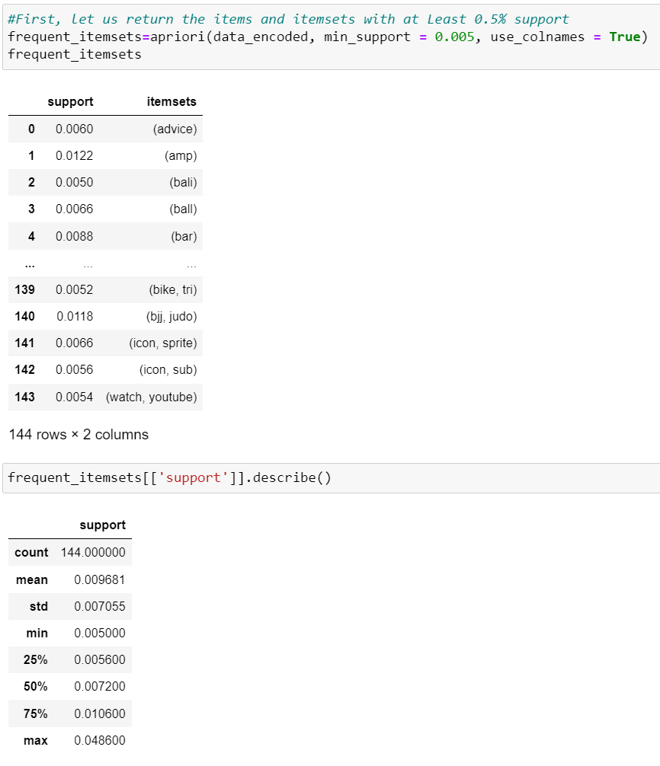
Generate frequent itemset
Support threshold of 0.5% was used
Filtered out items which were present in < 0.5% of all documents

Slide 33
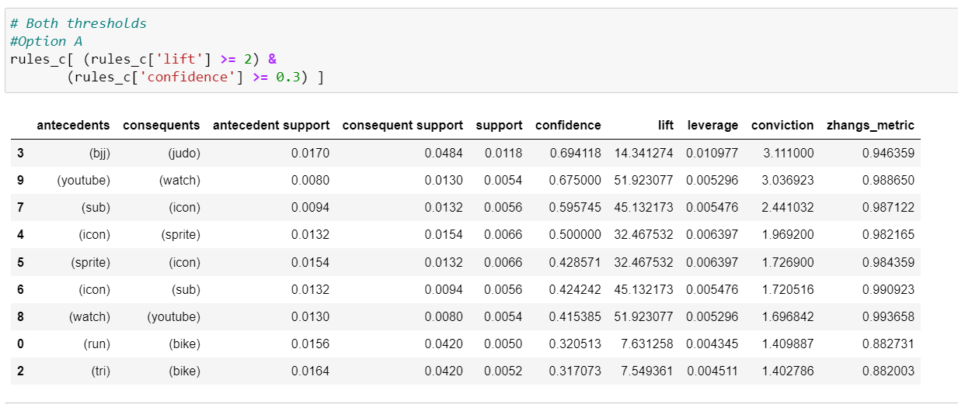
Analysis All Category
Rules with the highest support belong in Judo, soccer, and Triathlon Categories.
Soccer: Content related to soccer watched on YouTube, icons related to sprite and balls.
Judo: Comparison between Brazilian jiu-jitsu and Judo
Triathlon: Tri Bike and activities for triathlon.

Slide 34

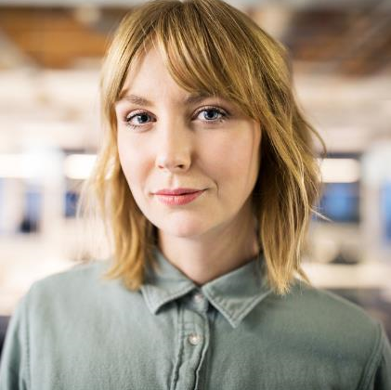

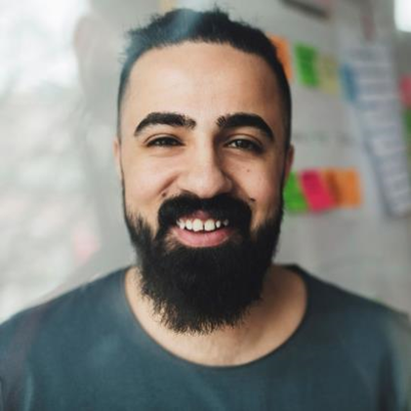
MEET OUR TEAM
Presentation title
TAKUMA HAYASHI
MIRJAM NILSSON
FLORA BERGGREN​
RAJESH SANTOSHI​
President
Chief Executive Officer
Chief Operations Officer
VP Marketing

Slide 35



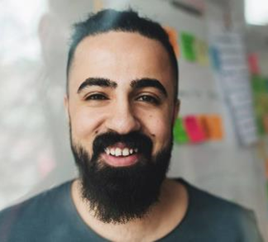
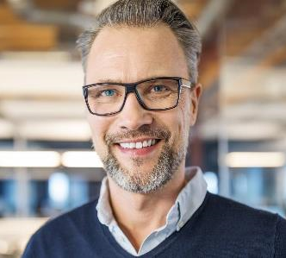



MEET OUR Extended TEAM
TAKUMA HAYASHI
MIRJAM NILSSON
FLORA BERGGREN​
RAJESH SANTOSHI​
President
Chief Executive Officer
Chief Operations Officer
VP Marketing
GRAHAM BARNES
ROWAN MURPHY
ELIZABETH MOORE
ROBIN KLINE
VP Product
SEO Strategist
Product Designer
Content Developer

Slide 36





PLAN FOR PRODUCT LAUNCH
Presentation title
PLANNING
MARKETING
DESIGN
STRATEGY
LAUNCH
Synergize scalable
e-commerce
Disseminate standardized
metrics
Coordinate e-
business applications
Foster holistically superior methodologies
Deploy strategic networks with compelling e-
business needs

Slide 37
TIMELINE
SEP 20XX
NOV 20XX
JAN 20XX
MAR 20XX
MAY 20XX
Synergize scalable
e-commerce
Disseminate standardized
metrics
Coordinate e-
business applications
Foster holistically superior methodologies
Deploy strategic networks with compelling e-
business needs

Slide 38
AREAS OF FOCUS
B2B MARKET SCENARIOS
CLOUD-BASED OPPORTUNITIES
Develop winning strategies to keep ahead of the competition
Capitalize on low-hanging fruit to identify a ballpark value
Visualize customer directed convergence
Iterative approaches to corporate strategy
Establish a management framework from the inside

Slide 39



HOW WE GET THERE
Presentation title
ROI
NICHE MARKETS
SUPPLY CHAINS
Envision multimedia-based expertise and cross-media growth strategies
Visualize quality intellectual capital
Engage worldwide methodologies with web-enabled technologies
Pursue scalable customer service through sustainable strategies
Engage top-line web services with cutting-edge deliverables
Cultivate one-to-one customer service with robust ideas
Maximize timely deliverables for real-time schemas

Slide 40
SUMMARY
Presentation title
At Contoso, we believe in giving 110%. By using our next-generation data architecture, we help organizations virtually manage agile workflows. We thrive because of our market knowledge and great team behind our product. As our CEO says, "Efficiencies will come from proactively transforming how we do business."

Slide 41
THANK YOU
Mirjam Nilsson​
mirjam@contoso.com
www.contoso.com

